Slide 1
SESSION 1
From Engineering or Disciplinary Problem
to Machine Learning Problem
Goal: leave with a defensible ML problem statement for a research, teaching, or operational challenge.
Applied AI Design Workshop
Session focus
• Prediction objective
• Inputs and target
• Unit of observation
• Baseline model
• Success criteria
• Data-readiness risks
Fred Livingston (fjliving@ncsu.edu) 2026
1

Slide 2
APPLIED AI DESIGN WORKSHOP
Session 1
Workshop outcomes
By the end of the Day 3 foundations block, faculty should be able to design a credible starting point for applied AI — before selecting a tool or model.
Translate
Turn disciplinary questions into ML tasks
Differentiate
Regression, classification, clustering, forecasting
Baseline
Establish a simple reference model
Evaluate
Choose initial metrics based on consequence of error
Connect
Position classic ML within applied AI workflows
Today’s emphasis: problem framing is a design activity, not just a coding step.
2

Slide 3
APPLIED AI DESIGN WORKSHOP
Session 1
Day 3 schedule and flow
From engineering problem to ML problem
Now
Classic ML overview
Framing
Invited presentation: From Prompts to Agents
Context
Break
Regression fundamentals
Methods
Classification fundamentals
Hands-on baseline model activity
Practice
3

Slide 4
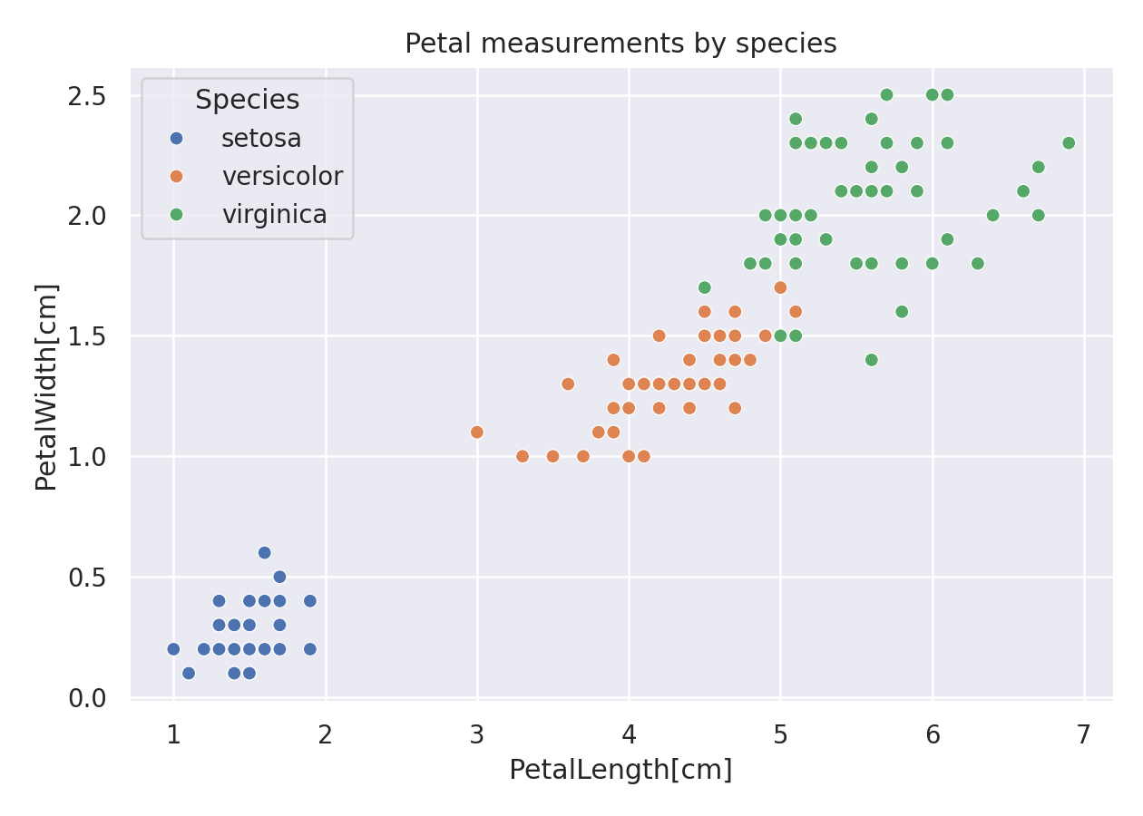
APPLIED AI DESIGN WORKSHOP
Session 1
Embedded Technical Skills
pandas → visualization → regression → classification → complete workflow
Session
Tool skill
What faculty practice
Session 1
pandas data loading
Load CSV, inspect rows/columns, define inputs and target
Session 2
visualization
Scatterplot, histogram, target count plot
Session 3
regression in scikit-learn
Split, baseline, train, predict, MAE and R²
df = pd.read_csv("iris.csv")
X = df[["PetalLength_cm", "PetalWidth_cm"]]
y = df["Species"]
model.fit(X_train, y_train)
Session 4
classification in scikit-learn
Majority baseline, logistic regression, confusion matrix, precision/recall/F1
Session 5
complete workflow
Load → inspect → visualize → split → baseline → train → evaluate
4

Slide 5
APPLIED AI DESIGN WORKSHOP
Session 1
Learning activities for Session 1
1. Frame
2. Map
3. Classify
4. Check
5. Defend
Write a discipline-specific challenge
Identify inputs, target, and observation unit
Select regression / classification / clustering / forecasting
Look for leakage, label, and feasibility risks
Propose baseline and success metric
Participant output: one polished ML problem statement ready to reuse in course planning, research ideation, or proposal development.
4

Slide 6
APPLIED AI DESIGN WORKSHOP
Session 1
The core design question
Before asking “which model?” ask:
What decision, prediction, or insight should improve because this model exists?
Prediction
Estimate an unknown or future value
Decision support
Rank, flag, recommend, or screen
Discovery
Reveal patterns for further study
The problem framing determines the data, model family, metric, and interpretation.
5

Slide 7
APPLIED AI DESIGN WORKSHOP
Session 1
Anatomy of an ML problem statement
Inputs
Model task
Target
Unit
Metric
sensor readings
process parameters
student records
regression
classification
forecasting
yield, defect, score
fault, class, demand
part, batch, patient
student, machine cycle
MAE, RMSE, R²
precision, recall, F1
Using ______ as inputs, develop a ______ model to predict or identify ______ for each ______, evaluated by ______.
6

Slide 8
APPLIED AI DESIGN WORKSHOP
Session 1
Define the four essentials
Input variables
What the model is allowed to know
Temperature, pressure, vibration, assignment activity
Target variable
What the model is trying to estimate
Yield, final strength, fault status, retention risk
Unit of observation
One row or prediction case
Part, batch, machine cycle, patient, student, building-day
Output format
How the model returns information
Continuous value, probability, class label, cluster ID
Rule of thumb: inputs must be available at the time the prediction is made.
7

Slide 9
APPLIED AI DESIGN WORKSHOP
Session 1
Choose the ML task from the question
Regression
How much?
final strength, energy, yield
Classification
Which category?
defect / no defect, pass / fail
Clustering
What groups exist?
operating regimes, student profiles
Forecasting
What happens next?
demand, sensor trajectory
Anomaly Detection
Is this unusual?
faults, outliers, rare events
8

Slide 10
APPLIED AI DESIGN WORKSHOP
Session 1
Examples across disciplines
Domain
Question
ML task
Possible target
Manufacturing
Will this run produce an acceptable part?
Classification
Accept / defect
Materials
What final strength will result?
Regression
Tensile strength
Energy
What will demand be tomorrow?
Forecasting
kWh demand
Education
Which learners need support?
Classification
Support-risk category
Bioprocessing
Which runs have similar behavior?
Clustering
Operating group
Same dataset, different question → different model design.
9

Slide 11
APPLIED AI DESIGN WORKSHOP
Session 1
Baselines and success criteria
A baseline answers: “What would happen if we did something simple?”
Regression baseline
Predict the mean or median of the training target
Classification baseline
Predict the majority class or simple rule
Operational baseline
Use current practice, expert rule, or manual workflow
Success criteria combine technical performance and practical consequence:
Metric threshold: e.g., recall ≥ 85% for rare faults
Scientific usefulness: e.g., interpretable features for follow-up study
Practical constraint: e.g., fewer than 5 false alarms per week
Adoption criterion: e.g., model informs a real decision in the workflow
10

Slide 12
APPLIED AI DESIGN WORKSHOP
Session 1
Data-readiness checks before modeling
Labels
Is the target measured reliably?
Timing
Are inputs available before prediction?
Leakage
Did we accidentally include the answer?
Sample size
Are there enough observations for the task?
Representation
Do data cover relevant conditions?
Error cost
What errors matter most?
Data quality is not a preprocessing detail; it determines whether the ML problem is answerable.
11

Slide 13
APPLIED AI DESIGN WORKSHOP
Session 1
problem-framing canvas
Disciplinary problem
What challenge or opportunity motivates AI?
Prediction objective
What should be predicted, flagged, ranked, or discovered?
Unit of observation
What does one row or prediction case represent?
Inputs
What data are available before the prediction?
Target
What is the outcome or label?
Baseline + metric
What simple approach and evaluation metric will you compare against?
What would make your problem statement scientifically or operationally defensible?
12

Slide 14
APPLIED AI DESIGN WORKSHOP
Session 1
Worked example: machine-condition prediction
Problem
Reduce unexpected downtime in a manufacturing cell
Objective
Predict fault risk in the next 24 hours
Task
Binary classification
Inputs
current, vibration, temperature, cycle time
Unit
one machine cycle or shift
Target
fault / no fault label
Baseline
predict no fault
Metric
recall for fault class
13

Slide 15
APPLIED AI DESIGN WORKSHOP
Session 1
Discussion prompts
What decision would change if the model worked?
Can the target be measured reliably?
Are inputs available before the prediction?
What type of error is most costly?
What simple baseline must be beaten?
Would strong prediction imply understanding or causality?
Use these prompts to move participants from “I have data” to “I have a well-posed ML design problem.”
15

Slide 16
APPLIED AI DESIGN WORKSHOP
Session 1
Example Machine Learning Template
Write your ML problem statement:
Using __________ as inputs, develop a __________ model to predict or identify __________ for each __________, evaluated by __________.
What is the decision?
What data are available?
What is the target?
What is the baseline?
18

Slide 17
APPLIED AI DESIGN WORKSHOP
Session 1
Before you begin
You should have:
1
A problem statement
2
A selected task type
3
Defined inputs, target, unit of observation
4
A baseline model or current-practice comparison
5
An initial metric and practical success criterion
6
One risk to resolve before modeling
Transition: Session 2 will place this framed problem into the broader classic ML landscape.
16

Slide 18
APPLIED AI DESIGN WORKSHOP
Session 1
Session 1 technical skill: load, inspect, frame
Goal: make inputs, target, units, task, baseline, and metric explicit before modeling.
import pandas as pd
df = pd.read_csv("iris_workshop.csv")
df.head()
df.shape
df.dtypes
df.isna().sum()
What faculty should identify
• What does one row represent?
• Which columns are inputs?
• What is the target?
• What are the units?
• Is the task regression, classification, clustering, or forecasting?
Session 1 notebook
01_session1_loading_and_framing.ipynb
Instructor prompt
“Before we choose a model, describe the problem using the table: unit of observation, inputs, input units, target, task, baseline, metric.”
16

Slide 19
APPLIED AI DESIGN WORKSHOP
Session 1
Session 1 example: the Iris problem as a framing template
Use a familiar dataset to model the vocabulary faculty will apply to their own disciplines.
Unit
Inputs
Units
One flower
Petal length, petal width
Centimeters
Target
Task
Metric
Species
Multiclass classification
Accuracy
input_columns = ["PetalLength_cm", "PetalWidth_cm"]
target_column = "Species"
X = df[input_columns]
y = df[target_column]
16

Slide 20
APPLIED AI DESIGN WORKSHOP
Session 1
Key takeaways
Applied AI design begins with problem formulation, not model selection.
Define the prediction objective in decision-relevant language.
Separate inputs, target, output, and unit of observation.
Select the ML task based on the question being asked.
Use baselines and metrics to avoid vague claims of “good performance.”
Check data availability, leakage, labels, and error consequences early.
Next: Classic machine learning overview — matching framed problems to model families.
17

